Slide 1
Colony Guest Register
A Simple database based project to register guest info

Slide 2
Group Members
1
Abida Kahn Trisha : 172-15-9696
Ferdaus Zaman Polok : 172-15-9924

Slide 3
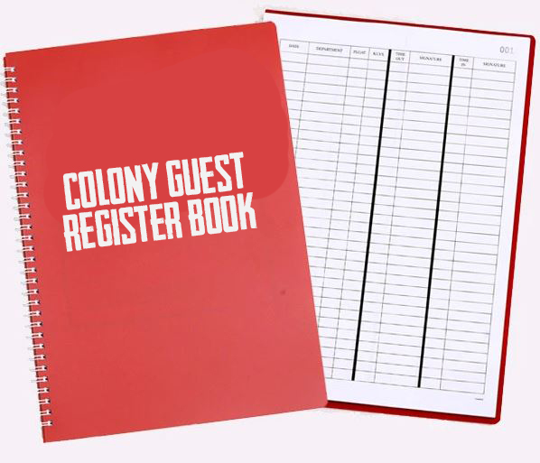
Introduction
2
Digital version of Guest Register Book
THEN

Slide 4
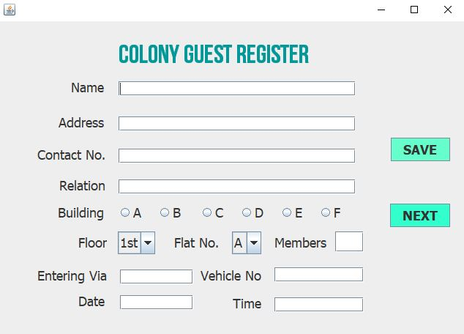
Introduction
3
Digital version of Guest Register Book
NOW

Slide 5


How it works?
4
Build in Jframe
Connected With Xamp

Slide 6
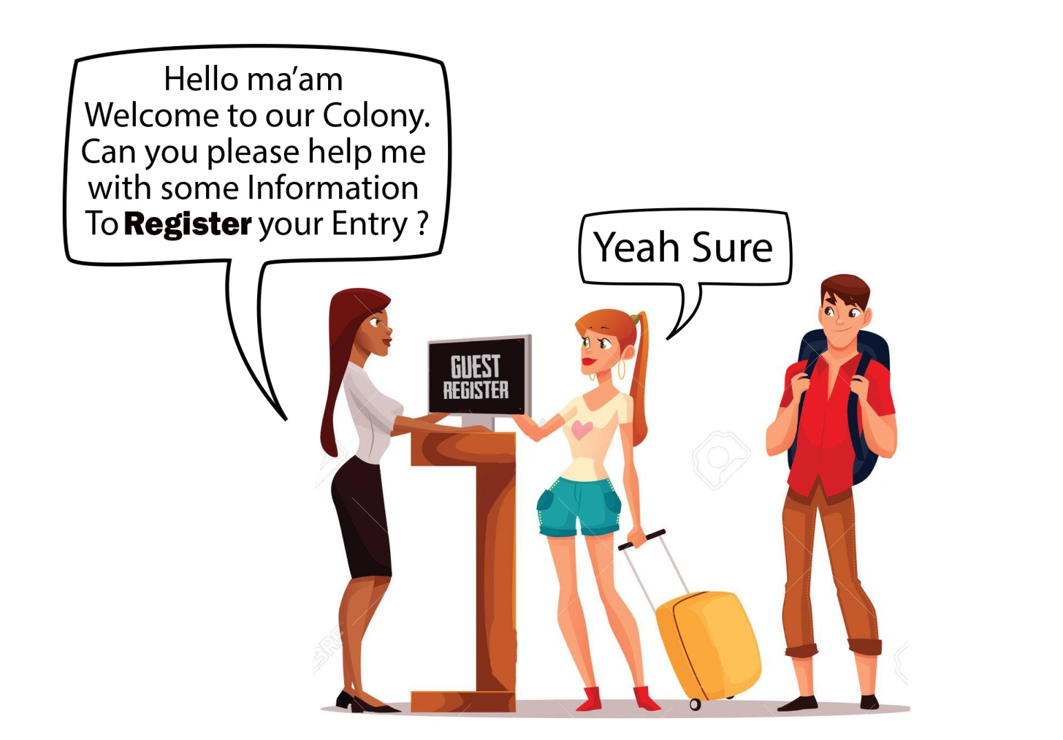
Advantages?
5
Saves Time
Easy to find data

Slide 7
Working Process
7

Slide 8
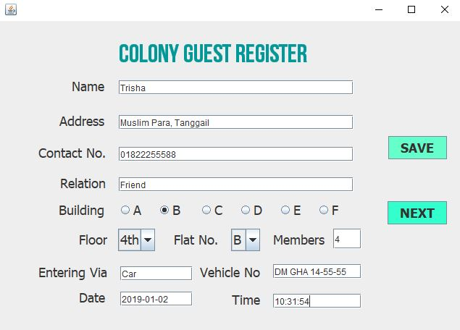
Working Process
8

Slide 9
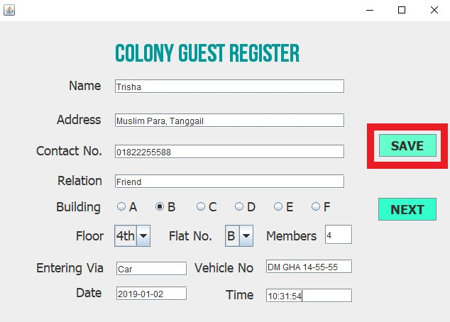
Working Process
9

Slide 10
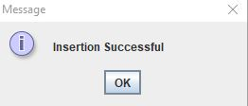
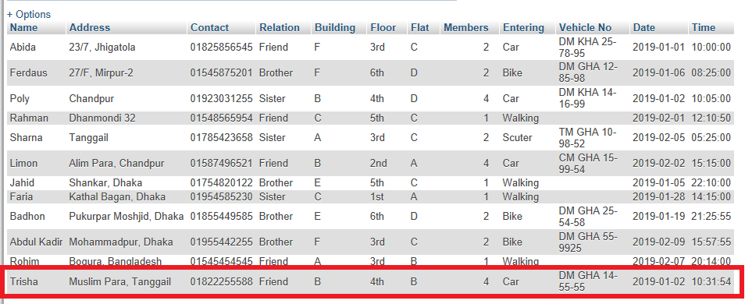
Working Process
10

Slide 11
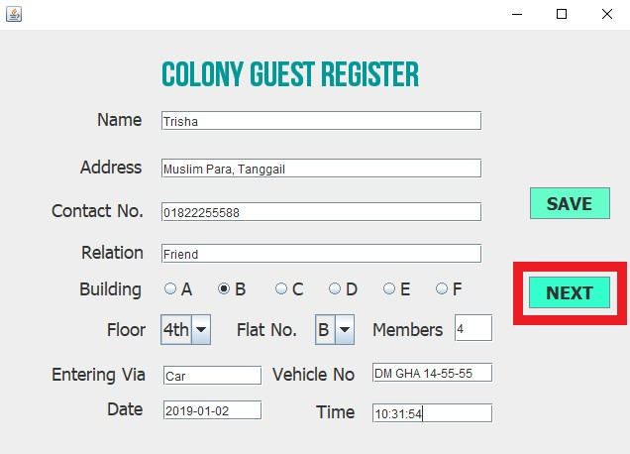
Working Process
11

Slide 12
Working Process
12

Slide 13

Future Work
13
Make Android app
Admin Panel [ Data Entry from Gate ]
User Panel [ Flat Owners ]

Slide 14
Thank You
ANY QUESTIONS?

